Slide 1
Fisher 1935
Tegmark, Taylor, Heavens 1997

Slide 2
likelihood
parameter
parameter 1
parameter 2

Slide 3



What is the (Fisher) Matrix?
Lets expand a likelihood surface about the maximum likelihood point
Can write this as a Gaussian
Where the Hessian (covariance) is

Slide 4


What is the Fisher Matrix?
The Hessian Matrix has some nice properties
Conditional Error on α
Marginal error on α
Matrix inversion performed

Slide 5
likelihood
parameter
condition
parameter 1
marginalise
parameter 2

Slide 6


What is the Fisher Matrix?
The Fisher Matrix defined as the expectation of the Hessian matrix
This allows us to make predictions about the performance of an experiment !
The expected conditional error on α: σ_{α}=√(1/F_{αα})
The expected marginal error on α
Matrix inversion performed

Slide 7

The Gaussian Case
How do we calculate Fisher Matrices in practice?
Assume that the likelihood is Gaussian

Slide 8





The Gaussian Case
derivative
matrix identity
derivative

Slide 9
How to Calculate a Fisher Matrix
We know the (expected) covariance and mean from theory
Requires NO DATA!
Worked example y=mx+c

Slide 10
Theory: y=mx
New Experiment can measure y with error σ(y)
What value of x is best for measuring m?
y
σ(y)
x

Slide 11
The theory: y=mx
Experiment can measure σ(y)
Question: what x value is best?
Covariance does not depend on m so first term zero
dy/dm=x
F_{mm}=(1/σ²(y))x²
σ(m)=√[F⁻¹_{mm}]=√[σ²(y) x⁻²]=σ(y) x⁻¹
Better measure of m at large x

Slide 12
Better at large x
More lever on m
y
σ(y)
x

Slide 13
Some nomenclature
σ(m)=√[F⁻¹_{mm}]=√[σ²(y) x⁻²]=σ(y) x⁻¹
Need a “fiducial” value to make quantitative predictions
If derivative is analytic then fairly straightforward (not always the case!)

Slide 14
Some nice properties of Fisher matrices
F= A B
C D
Matrix Manipulation:
Inversion F⁻¹
Addition F=G+H
Rotation G=RFR^{T}
Schur Complement F_{A}=A-BD⁻¹C
(
(

Slide 15

Adding Extra Parameters
To add parameters to a Fisher Matrix
Simply extend the matrix

Slide 16
Combining Experiments
If two experiments are independent then the combined error is simply
F_{comb}=F₁+F₂
Same for n experiments
If not independent need to have a single Fisher matrix with a joint covariance

Slide 17
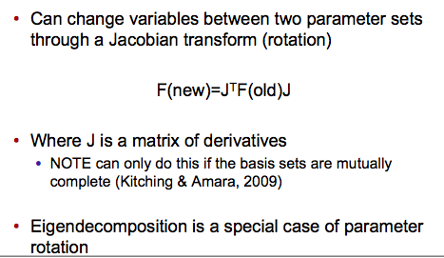

Re-Parameterising

Slide 18

parameter 1a
parameter 1b
parameter 2b
parameter 2a

Slide 19

Schur Complement
Schur Complement F_{A}=A-BD⁻¹C
This is equivalent of the following operation
Invert entire matrix F⁻¹
Select the A-part of the inverse F⁻¹(A)
Reinvert
What you have is a new “sub” Fisher matrix
What is does this correspond to ?

Slide 20
Schur Complement is equivalent of marginalisation over parameters
Schur Complement
F_{A}=A-BD⁻¹C < A
Marginalises over parameters not-A
condition
parameter 1
marginalise
parameter 2

Slide 21
likelihood
parameter
condition
parameter 1
marginalise
parameter 2

Slide 22
A Warning about derivatives
B
A
likelihood
parameter
dL/dparameter= (B-A)/dp
Or can approximate using q parabola
Numerically must test if this is stable

Slide 23
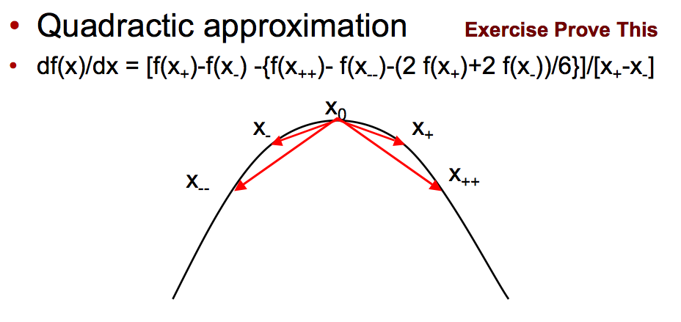

Slide 24
Warning about the two terms
Can we use both terms and get twice the information?
No not usually (almost never in cosmology)

Slide 25
Fisher matrices must be positive definite
A positive definite matrix has
ONLY POSITIVE EIGENVALUES
Because by definition the likelihood surface is assumed to be single peaked
parameter
Can get non-positive definite due to numerical inaccuracies
Corresponds to a convex(negatively) curved surface
Should always check matrices

Slide 26
Fisher Future Forecasting
We now have a tool with which we can predict the accuracy of future experiments!
Can easily
Calculate expected parameter errors
Combine experiments
Change variables
Add extra parameters

Slide 27

For shear the mean shear is zero, the information is in the covariance so (Hu, 1999)
This is what is used to make predictions for cosmic shear and dark energy experiments

Slide 28
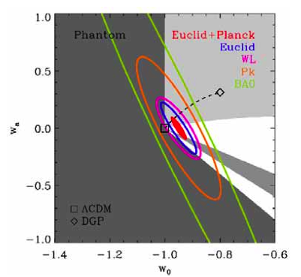
Dark Energy
Expect constraints of 1% from Euclid

Slide 29
The theory: y=mx
Experiment can measure σ(y)
Question: what x value is best?
dy/dm=x
F_{mm}=(1/σ²(y))x²
σ(m)=√[F⁻¹_{mm}]=√[σ²(y) x⁻²]=σ(y) x⁻¹
Better measure of m at large x

Slide 30
The theory: w(z)=w₀+w_{a}(1-a)
Experiment can measure σ(C_{l})
Question what redshift/area?

Slide 31

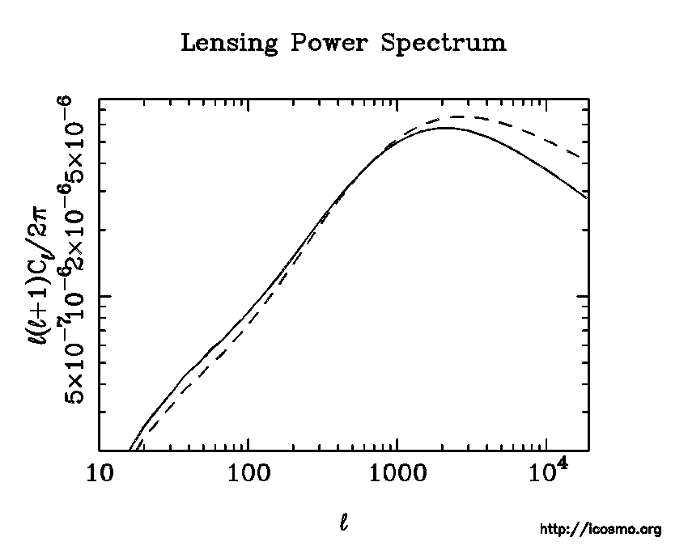
Know from
Theory/Simulations
✓
✓
Mean is shear is zero

Slide 32
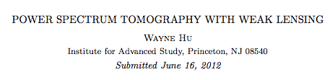
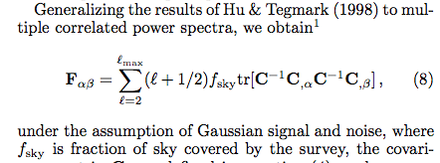
Hu 1999
l+1/2 sums over m-modes
f_{sky} scales the covariance with the survey area
Note also need to include noise on covariance C=C(l)+N
N=σ(e)/n_{galaxy}

Slide 33
Question we have address is:
Given an experiment how accurate can I measure parameter values?
Alternative/additional question is
How accurately can I determine a model (set of parameters)

Slide 34
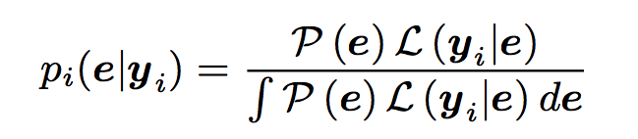
Bayes’ Theorem
Measure likelihood of data given parameters
Assume prior on parameters
Evidence for a Model (set of parameters)
Prior
Likelihood
Evidence
Posterior

Slide 35



How to compute expected evidence?
Evidence
Bayes Factor=Ratio of Evidences

Slide 36
What does the Bayes factor mean?
Odds: how much would you gamble?
Jeffereys Scale (take with a pinch of salt)
LnB < 1 “inconclusive”
1< LnB < 2.5 “significant” odds ~1:12
2.5 < LnB < 5.0 “strong” odds ~1:150
LnB > 5.0 “decisive” odds better than 1:150

Slide 37

Can assume Gaussian likelihoods and perform the integration (Heavens, Kitching, Verde, 2008)
Can compute from the Fisher matrix the expected evidence for nested models
Other similar approaches in Trotta (2008)
“Occam Factor” can be seen

Slide 38

Occam Factor
Occam’s Razor: Simpler models are prefered
Stops you over fitting your data
Would need
More
Parameters

Slide 39
Example from neutrino mass from weak lensing
Neutrinos have mass = model A
Neutrinos do not have mass = model B

Slide 40
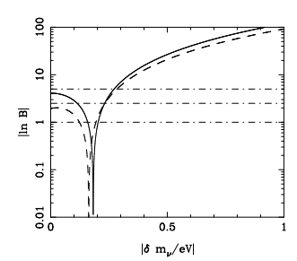
Example from neutrino mass from weak lensing
decisive
strong
significant
inconclusive
Euclid-like survey: Kitching et al. 2008

Slide 41
What will we learn?
Fisher matrices
Likelihood sampling

Slide 42
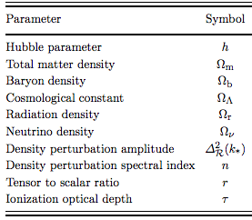
Likelihood Sampling
We have at least 10 cosmological parameters
Others may be
non-zero
functions of scale and/or redshift
w(z)+1
b(z,k)-1

Slide 43
parameter 1
parameter 2
Grid. Evaluate likelihood function at a grid of points in
parameter space
What is wrong with this approach? N^{D}

Slide 44
MCMC Methods
Monte Carlo Markov Chain
Randomly Sample Likelihood Space
A chain of likelihood (or other) evaluations
that is “memoryless”

Slide 45
Metropolis-Hastings
Sample likelihood space with a random walk
Pick a point in parameter space x_{i}
Evaluate likelihood L(x_{i})
Pick a new random point x_{i+1} from a proposal distribution
Evaluate likelihood L(x_{i+1})
If a=L(x_{i+1})/L(x_{i})>1 ACCEPT (and goto 3)
Accept with probability a
Draw a uniform random number b and if b<a ACCEPT else reject

Slide 46
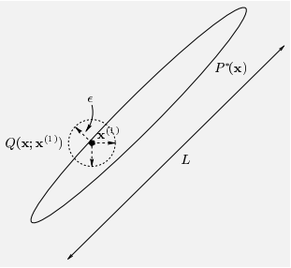
What choice of proposal?
Common to choose multivariate
Gaussian (inefficient for degenerate
parameters)
Could also choose the Fisher
matrix

Slide 47
Pick a point in parameter space x_{i}
Evaluate likelihood L(x_{i})
Pick a new random point x_{i+1} from a proposal distribution
Evaluate likelihood L(x_{i+1})
If a=L(x_{i+1})/L(x_{i})>1 ACCEPT (and goto 3)
Accept with probability a
Draw a uniform random number b and if b<a ACCEPT else reject
parameter 1
Rand(B)
L4/L3>B
L4<L3
L3>L2
L2>L1
L4<L3
Rand(B)
L4/L3<B
L1
parameter 2
parameter 1
parameter 2

Slide 48
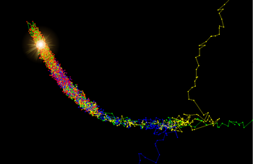
The density of points is proportional to the likelihood
“run in”

Slide 49


Convergence
When to stop (never!)
But chain will “converge”
Gelman-Rubin
“variance between chains consistent with variance within a chain”
Run multiple chains; m group of n chains n chains
W=mean variance over chains
B=variance between chains
σ unbiased estimate of target
m groups of n chains
V=1 means convergence

Slide 50
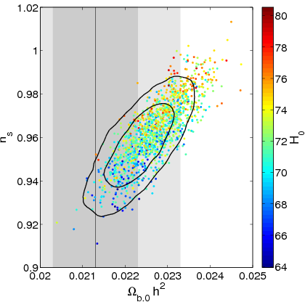
MCMC for Cosmology
Most commonly used package is
cosmomc http://cosmologist.info/cosmomc/
Coupled with CAMB
Used for WMAP analysis (and many others)
Can download WMAP MCMC chains to play around with
http://lambda.gsfc.nasa.gov/toolbox/

Slide 51
Other MCMC methods
What are the problems with MCMC?
Multiple peaks
Evidence?
Have some different types/flavours
Gibbs sampling
Simulated annealing
What alternatives?
Nested Sampling
Feroz & Hobson (2008), reﬁned by Feroz, Hobson & Bridges (2008)
Population Monte Carlo
Kilbinger et al. 2009

Slide 52
Recap
Predictive parameter and model estimation
Fisher Matrix
Evidence
Real Life parameter and model selection
MCMC

